Slide 1
What about our Network!?
Brainstorm 2019
Notes:
During this presentation we will share a journey of changing involvement, infrastructure discovery and ownership… All in the efforts to ensure that we have an uneventful school year while providing the best uninterrupted network service for Students, Teachers and the classroom experience. Technology can never be the obstacle to a positive learning environment.

Slide 2
Duane Retzlaff
Oshkosh Area School District
Aug - 1998 - Various Technology roles
Previous technology consulting also manufacturing leadership roles.
duane.retzlaff@oshkosh.k12.wi.us
Oshkosh Area School District
10,000 Students
1,100 Staff
22 Sites - Fiber connected
Notes:
Duane opens with brief introduction.
Hand off to Mat Intro Click to next slide

Slide 3
Mat Wolfgram
Account Manager
Capital Data
mwolfgram@capital-data.com
Capital Data
100 W. Lawrence Street Suite 105
Appleton WI, 54914
www.capital-data.com
Notes:
Mat - Brief introduction
Click to next slide

Slide 4
What about our Network!?
Brainstorm 2019
Notes:
How did it come for us to present?
Repeat Brainstorm presenter - Enjoy the event and have enjoyed other presentations from various school districts
Thought we had a relatable story worth sharing
Why is our story worth your time?
Hopefully it will be informative
Help you realize that you are not alone with similar realities
Reinforce the value of partnerships
Click to next slide

Slide 5
June 2018
Changes in support
Redefining of roles:
Take Lead/Ownership
Develop an understanding of “What do we know?”
Identify systems and known status
Notes:
Recent upgrade efforts along with organizational changes provided a unique opportunity to dig in and:
Look at screen - Click through and comment on each..
Take Lead/Ownership
Develop understanding of “What we know” or where we are.
Identify systems and their known status
So… What do we know???? Click to next slide

Slide 6
What do we know
Inventory of equipment and status
Phone system replacement
166 edge switches
891 AP’s
1250+
Clients
Outdoor Wireless
Wireless = 14,339
Wired = 1500
Both High Schools
Questions - Licensing, System Functionality
Security cameras and more to come!
ISE, Prime
Networked Projectors
800 + 300
800
Notes:
Look at screen - Click through and comment on each..
Looks like we have some Research to do… Click to next slide

Slide 7
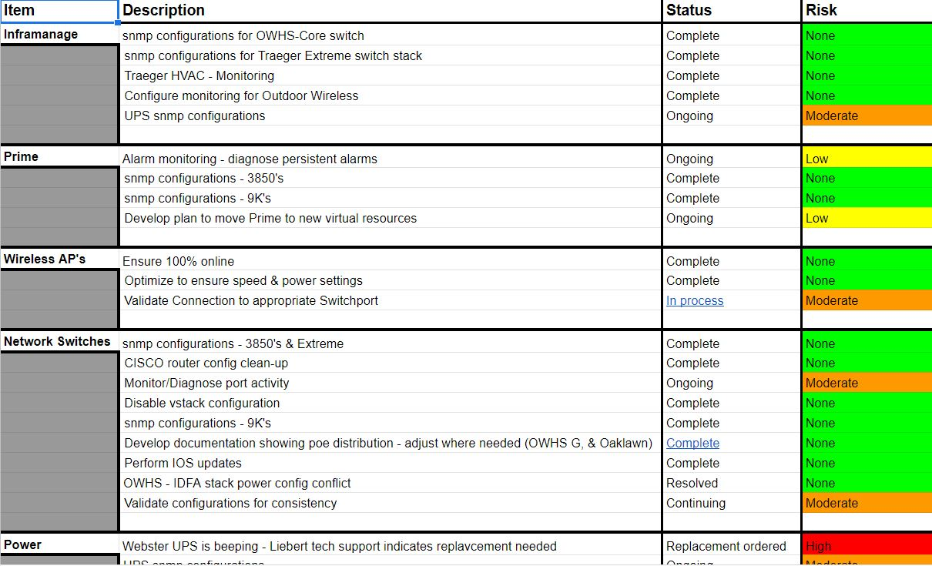
July 2018
Understanding of Current Status:
License
Support Contracts
Support status
Software versions
Research
Notes:
We developed a risk assessment
Understanding of Current Status
License - do any need renewal?
Support Contracts - What do we have and are we covered adequately?
Support status - What types of support might we need
Software versions - What versions are we on?.. Do we need to upgrade?
What needs attention?? Click to next slide

Slide 8
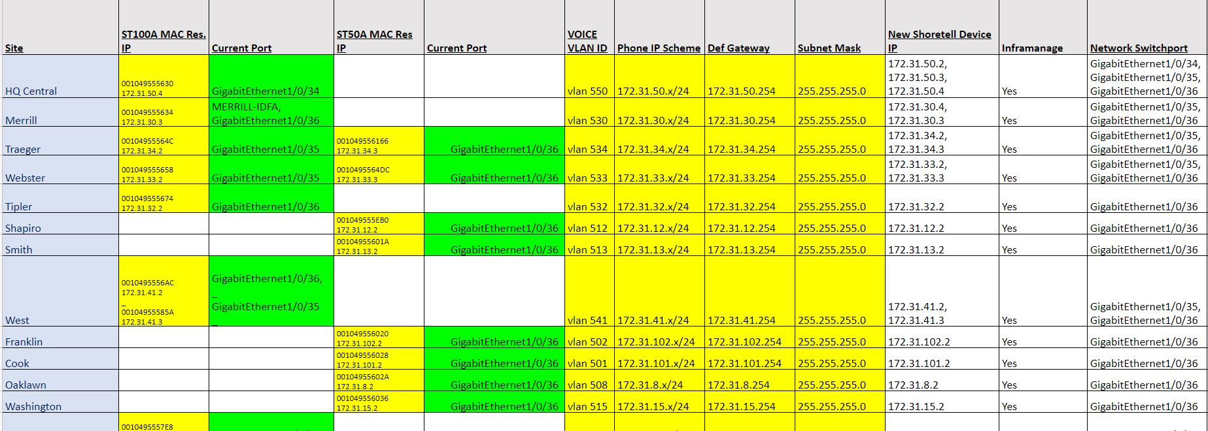
What needs attention?
Phone system replacement
Supporting Network Configurations
Notes:
We needed to ensure that we performed supporting network configurations for the phone system replacement.
Leverage existing “VOICE” network vlans and configurations as much as possible.
Standardize component connections…
Perform routing and switchport configurations. Click to next slide

Slide 9
What needs attention?
Phone system replacement
Supporting Network Configurations
Outdoor Wireless
Work underway
Notes:
Mosty light involvement to help ensure needs are met leveraging external partnership to complete. Click to next slide

Slide 10
What needs attention?
Phone system replacement
Supporting Network Configurations
Outdoor Wireless
Work underway
Networked Projectors
No Change
Notes:
Networked projectors - No changes… Click to next slide

Slide 11
What needs attention?
Phone system replacement
Supporting Network Configurations
Clients
Outdoor Wireless
Not much change expected
Work underway
Networked Projectors
No Change
Notes:
Clients - Not much change expected… Click to next slide

Slide 12
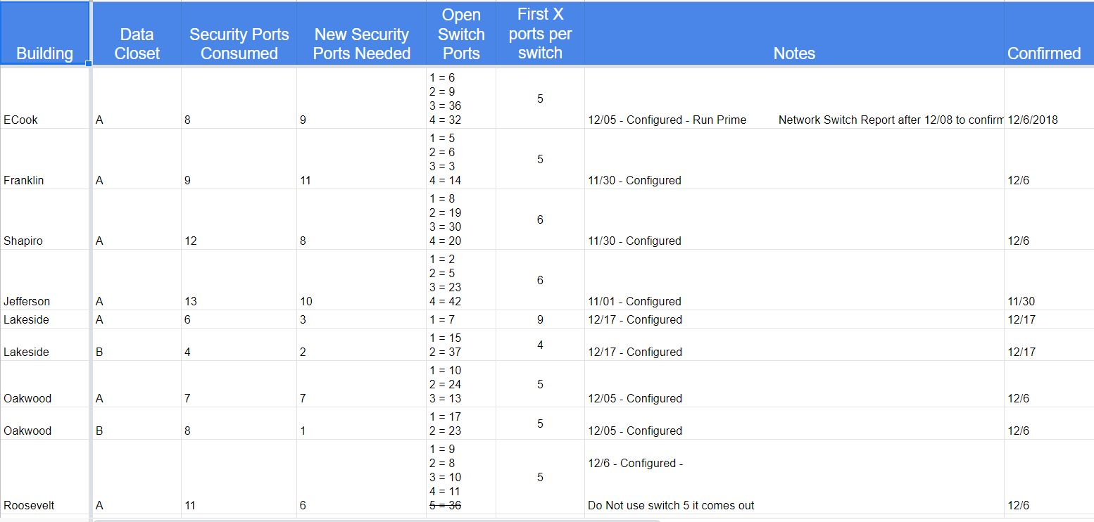
What needs attention?
Phone system replacement
Supporting Network Configurations
Clients
Outdoor Wireless
Not much change expected
Work underway
Security cameras and more to come!
Networked Projectors
Adjust Port Density
No Change
Notes:
Security cameras second phase… Work with internal resources and external partnerships
We identified switchport needs and worked to standardize… we performed supporting switch configurations.
This also helped us realize the need and start a port density study to allow for adjustments…
In some cases we needed additional port density to support added cameras also.. We worked to reduce excess port density where it isn’t needed…
A big bonus gained from this port density adjustment was the ability to create a Dev-stack of switches for testing and development… Click to next slide

Slide 13
What needs attention?
Inventory of equipment and status
All Edge switches need Updates
Two Data Center switches need replacement
AP’s were just updated.
Phone system replacement
Supporting Network Configurations
Clients
Outdoor Wireless
Not much change expected
Work underway
Security cameras and more to come!
Networked Projectors
Adjust Port Density
No Change
Notes:
The wireless AP’s were just updated so they along with the WLC’s were in good shape.
We identified two data center switches that need to be replaced as they would soon be out of support.
All the edge switches needed software updates… Click to next slide

Slide 14
What needs attention?
Inventory of equipment and status
All Edge switches need Updates
Phone system replacement
Supporting Network Configurations
Clients
Outdoor Wireless
Not much change expected
Work underway
Questions - Licensing, System Functionality
Prime should be rebuilt/Upgraded
Security cameras and more to come!
ISE needs License renewal
Networked Projectors
Adjust Port Density
8No Change
Notes:
Questions about licensing and system functionality…
ISE needed license renewal
Prime was suffering performance issues and needs to be rebuilt. So…
What will be our Plan of Attack?... Click to next slide

Slide 15
August 2018
Work with Partners to help develop plan:
License - ISE
Prime Rebuild and upgrade
Edge Switch Upgrade
Plan of Attack
Notes:
We reached out to our Partners to help develop plan
License - ISE
Prime Rebuild and upgrade
Edge Switch Upgrade Click to next slide

Slide 16
Plan of Attack
Inventory of equipment and status
All Edge switches need Updates
Phone system replacement
Supporting Network Configurations
Clients
Outdoor Wireless
Not much change expected
Work underway
Questions - Licensing, System Functionality
Security cameras and more to come!
ISE License renewal
Adjust Port Density
Notes:
First - let’s look at ISE Click to next slide

Slide 17
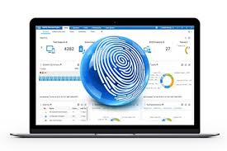
CISCO ISE License
Work with Partners to help:
Determine appropriate license
Develop Plan to install
Execute Work
Notes:
We Worked with Partners to determine
Appropriate license
Substantial savings $10,000 savings
We developed a Plan to install
We Executed the Work Click to next slide

Slide 18
Plan of Attack
Inventory of equipment and status
All Edge switches need Updates
Phone system replacement
Supporting Network Configurations
Outdoor Wireless
Work underway
Questions - Licensing, System Functionality
Prime Rebuild/Upgrade
Security cameras and more to come!
Adjust Port Density
Notes:
Now - let’s look at Prime… Click to next slide

Slide 19
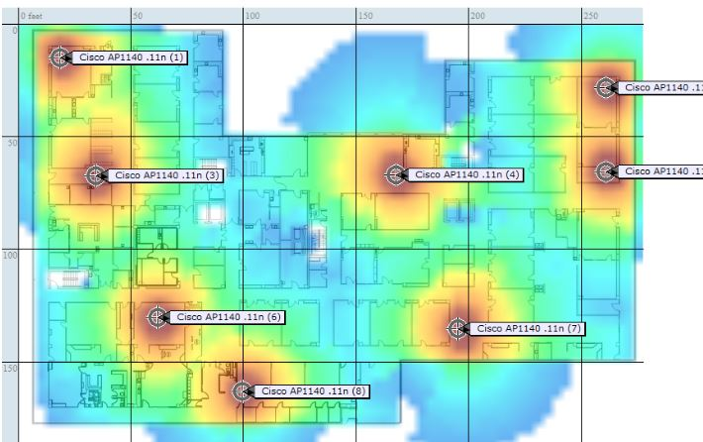
CISCO Prime
Work with Partners to help:
Determine appropriate Version
Develop Plan to install
Execute Work
Notes:
We Worked with Partners to help Determine
Appropriate Version = latest stable
Plan to install = Stand up new virtual server appropriately resourced
Execute Work = Backup existing, install new, migrate as much as possible from old.. Configure archives, snmp etc.. and optimize Click to next slide

Slide 20
What needs attention?
Inventory of equipment and status
Phone system replacement
Replace outdated data center switches
Supporting Network Configurations
Outdoor Wireless
Work underway
Security cameras and more to come!
Adjust Port Density
Notes:
We identified suitable replacements and developed a plan for installation Click to next slide

Slide 21
What needs attention?
Inventory of equipment and status
Phone system replacement
Update software code on all edge switches
Supporting Network Configurations
Outdoor Wireless
Work underway
Security cameras and more to come!
Adjust Port Density
Notes:
Utilize our new prime environment to perform these updates. Click to next slide

Slide 22
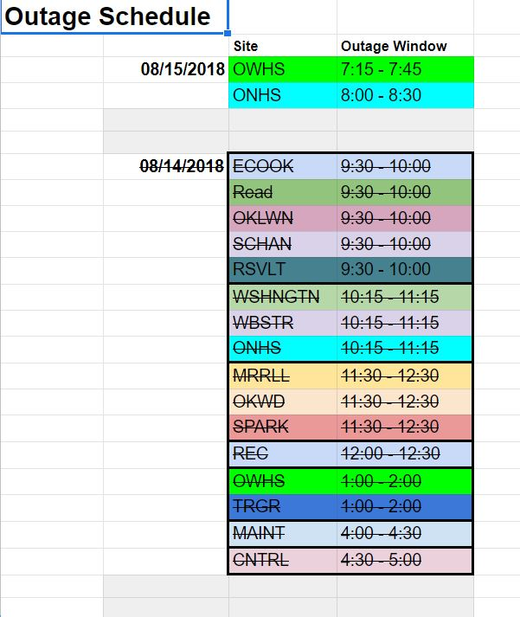
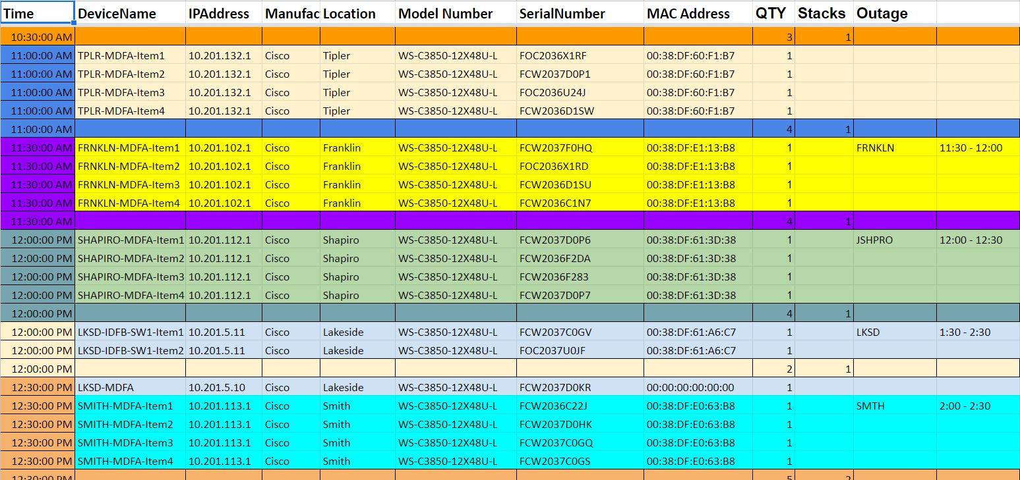
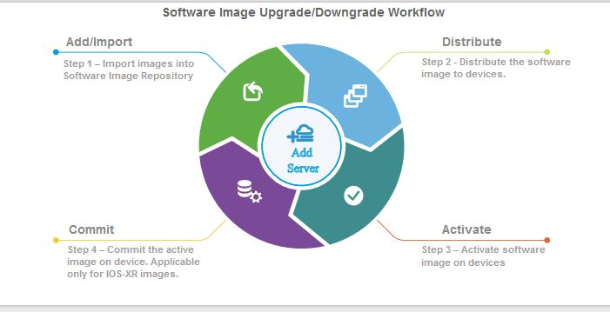
Update Edge Switch Software
Work with Partners to:
Use Prime to distribute and manage updates
Plan to install
Execute Work
Notes:
Work with Partners to determine
Look at screen - Click through and comment on each..
Use Prime Software Image Management to distribute and manage updates
Plan to install - Determine and schedule anticipated service outages
Execute Work - Communicate outages, validate switch-stack status (avail memory...), Distribute new image using Prime Image Management, Validate switch-stack status, cycle switch-stack power and validate network communication and services.
Click to next slide

Slide 23
Partner Advantage
Support with Knowledge Gap
Engineering and Architect Teams
Current Certifications
Relevant Experience
Multiple K-12 Environments
Multiple Industries
Team Approach
Notes:
Mat -

Slide 24
END
Notes:
We thought that we had a worthwhile story to tell
Maybe you were able relate and have faced similar experiences
Questions:

Slide 25
Resources:
Upgrade Device Software Images
Duane’s Additional Details

